Slide 1
GRAPH PRESENTATION OF DAILY LIKES AND ONLINE AND KEY METRICS
SECTION B
GROUP D
Sumit Shrestha
Prajjwal Sthapit
Sanjeev Budha
Sanjeev Mainali

Slide 2
Daily Liked And Online
Comparisons are done on the basis of month of two different years.
Total sum of likes and online daily was calculated month-wise on the basis of hours and data are presented in bar graph and line graph.

Slide 3
Comparison of 2013 and 2014 July

Slide 4
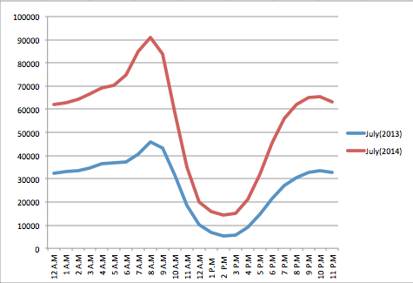

Slide 5
Comparison of 2013 and 2014 August

Slide 6
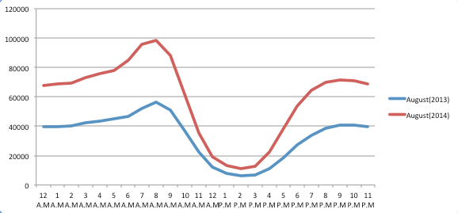

Slide 7
Comparison of 2013 and 2014 September

Slide 8
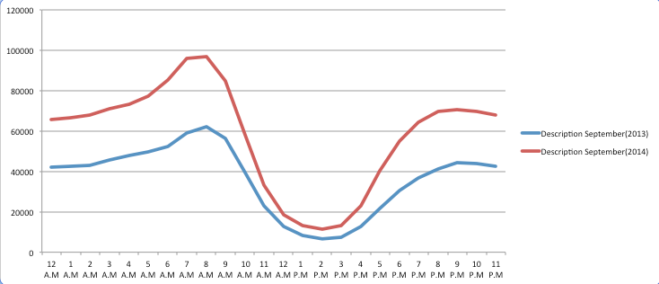

Slide 9
Comparison of 2013 and 2014 October

Slide 10
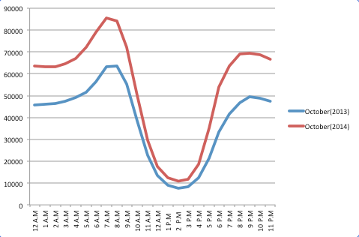

Slide 11
2013 and 2014 November

Slide 12
2013 and 2014 December

Slide 13
KEY METRICS
Daily new likes was chosen from two different years and was compared.
Comparison was done between the data of first quarter of year 2013 and first quarter of year 2014.
Total sum of new likes was calculated month-wise and data are presented in bar graph.
Total number of new news in 2013 and 2014 was also shown in bargraph.

Slide 14
Daily new likes

Slide 15
New users

Slide 18
Comparison on Total Impressions

Slide 19
Comparison on Reach of Page Posts

Slide 20
Line Graph analysis of Total Impressions

Slide 21
THANK YOU

